Slide 1
Intel Maker’s course Drivers and LCDs
Gil Tal.
Dec 2024

Slide 3
Agenda:
What is a device driver?
Arduino libraries (mainly drivers)
How to add a missing driver?
Our LCD and the TFT_eSPI.h library
graphics fundamentals:
Basic graphics controller
Our LCD and its connection to the ESP32
The TFT_eSPI.h library
Two main technics
Loading custom fonts
Hands on with our platform and the LCD:
Basic demo for our platform
Breakout game

Slide 4
Device driver
Device Driver
Micro Controller
(ESP32)
Enable us to:
Utilize the device’s capabilities
Initialize the device
Device
(LCD for Example)
Device Driver
SW structure
HAL
Hardware Abstraction Layer
User API
Application Programming Interface

Slide 5
Arduino Libraries
A dedicated folder for storing missing drivers to be used in the Arduino IDE
In our case located at:
By default, the folder is almost empty
Any missing driver, that we download needs to be placed in this folder
Basic libraries supplied by the Arduino IDE (like HardwareSerial.h) are not located here
So are the specific Micro Controller’s libraries (ESP32 for example)

Slide 6

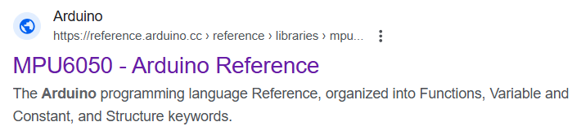
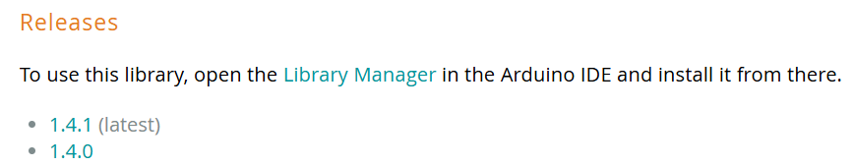
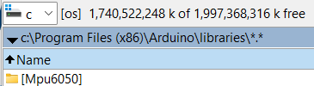
How to add a missing driver?
Searching in Google for a library designed for the Arduino IDE
For example: MPU6050 (GYRO + Accellometer with I2C interface)

Slide 7
Our LCD and the TFT_eSPI.h library
Our LCD is using the ST7789 controller and being interfaced using the SPI bus
There are many libraires supporting our ST7789, the TFT_eSPI.h is by far the best
SPI running at 40MHz one bit, with additional Command\Data control
Resolution: 320x240 or 240x320
RGB565 (64K colors): 30 FPS at max
Two bytes per pixel
Two operation modes:
Local frame buffer in ESP32’s memory + LCD’s frame buffer (using sprites)
One frame buffer within the LCD

Slide 8
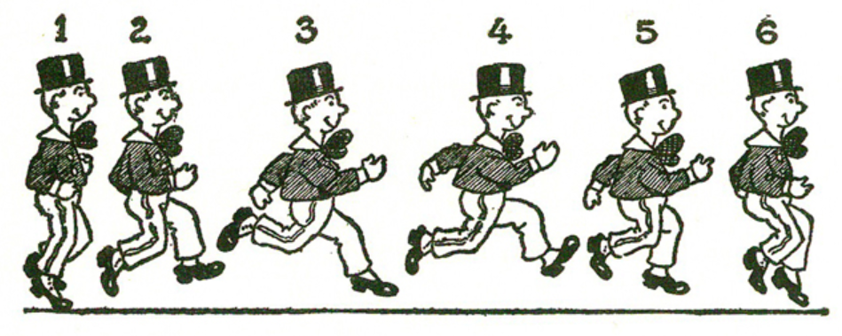
Animation basics…

Slide 9
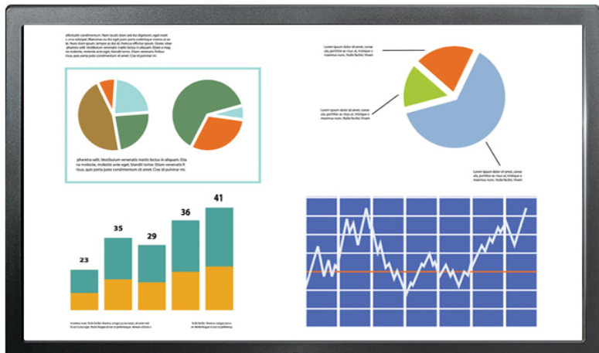
Basic graphics controller
Graphics
Memory
RGB
Graphics controller
(In our case – ST7789)
Interface to host
PCIe, SPI, I2C,UART, Parallel …
Memory structure:
Array of: RGB,RGB,RGB …. Or (ARGB,ARGB,ARGB…)
32, 24, 18, 16, or 3 bit per pixel (8888, 888, 666, 565, 111)

Slide 10
ESP32-S3 and the LCD block diagram
RGB565 mode – TFT_eSPI writes directly to the ST7789’s frame buffer memory
ESP32-S3
ST7789
LCD
SPI
Optional Local
Frame buffer
Frame buffer
Memory

Slide 11
Mapping the LCD of our platform
In general mistakes in connectivity can damage a board!
Information for physical connectivity must be available for us
Interface used by the LCD is SPI:
MOSI – Master out slave in (drive data from ESP32 to the LCD)
Clock
CS – Chip Select
Reset
Out of spec signal - CMD\Data , distinguish between data or command transactions
Information for the specific I/Os used is in the schematic of our platform
TFT_eSPI.h is a general LCD driver that supports the platform’s ST7789 device
Small porting is needed

Slide 12
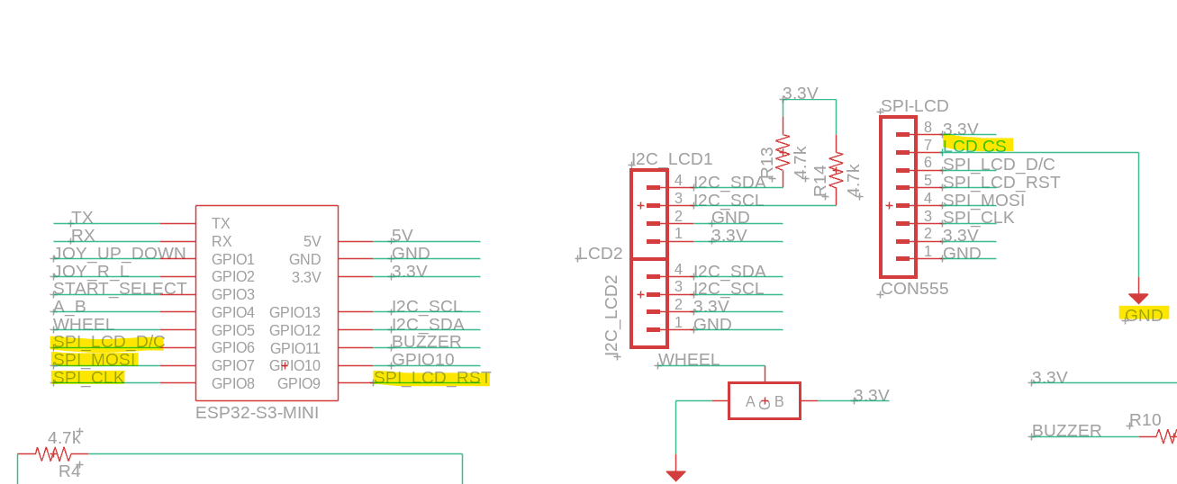
Our platform’s schematic

Slide 13
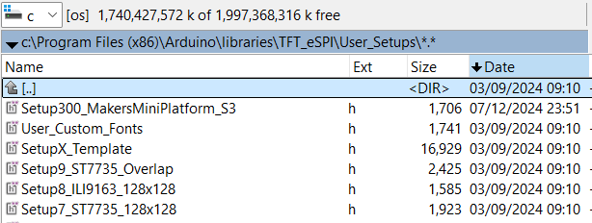
The TFT_eSPI.h library
Supports many LCDs controllers with optimizations for advanced MCUs (DMA for the ESP32-S3)
Need to create a config file for our platform or edit an existing one which describes the connectivity and few more attributes
Also support parallel mode (GPIO bit banging, or direct LCD dedicated units) to reach much higher FPS

Slide 14
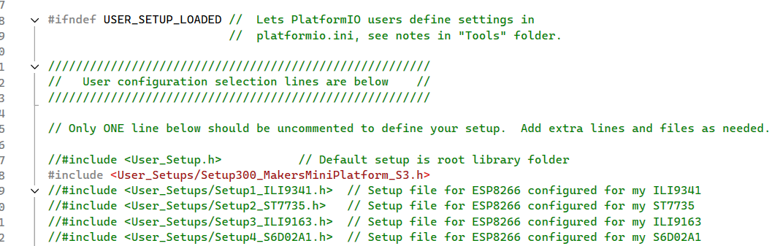

Slide 15
// ST7789 240 x 320 display with no chip select line
#define USER_SETUP_ID 300
#define ST7789_DRIVER // Configure all registers
#define TFT_WIDTH 240
#define TFT_HEIGHT 320
#define TFT_RGB_ORDER TFT_RGB // Colour order Red-Green-Blue
//#define TFT_RGB_ORDER TFT_BGR // Colour order Blue-Green-Red
#define TFT_INVERSION_ON
//#define TFT_INVERSION_OFF
#define TFT_BACKLIGHT_ON 1
#define TFT_BL 17 // LED back-light
#define TFT_MISO -1 // Not connected
#define TFT_MOSI 7
#define TFT_SCLK 8
#define TFT_CS 11
#define TFT_DC 6
#define TFT_RST 9 // Connect reset to ensure display initialises
//#define LOAD_GLCD // Font 1. Original Adafruit 8 pixel font needs ~1820 bytes in FLASH
//#define LOAD_FONT2 // Font 2. Small 16 pixel high font, needs ~3534 bytes in FLASH, 96 characters
#define LOAD_FONT4 // Font 4. Medium 26 pixel high font, needs ~5848 bytes in FLASH, 96 characters
#define LOAD_FONT6 // Font 6. Large 48 pixel font, needs ~2666 bytes in FLASH, only characters 1234567890:-.apm
//#define LOAD_FONT7 // Font 7. 7 segment 48 pixel font, needs ~2438 bytes in FLASH, only characters 1234567890:.
//#define LOAD_FONT8 // Font 8. Large 75 pixel font needs ~3256 bytes in FLASH, only characters 1234567890:-.
//#define LOAD_FONT8N // Font 8. Alternative to Font 8 above, slightly narrower, so 3 digits fit a 160 pixel TFT
//#define LOAD_GFXFF // FreeFonts. Include access to the 48 Adafruit_GFX free fonts FF1 to FF48 and custom fonts
#define SMOOTH_FONT
// #define SPI_FREQUENCY 27000000
#define SPI_FREQUENCY 40000000

Slide 16
Two main technics
Option 1:
Direct write to the LCD via SPI interface, almost no need for memory allocation on the ESP32-S3
Uses DMA (Direct memory access engine) in most cases
Option 2:
Use a sprite as a temp frame buffer
Erase the frame buffer
Draw the new scene
Send the new scene to the LCD
We need a frame rate greater than 26 for smooth animation
Uses DMA to drive the sprite into the LCD @ 30 FPS in our platform

Slide 17
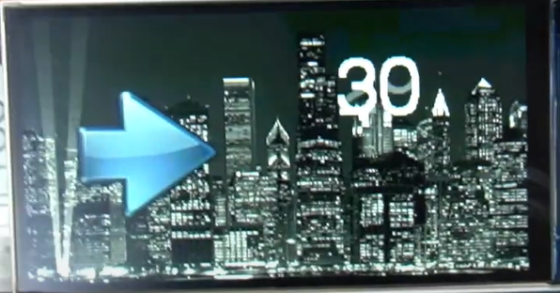
The TFT_eSPI’s Sprite entity
In the TFT_eSPI.h library, a sprite is an entity that represents an off-screen buffer or an image that can be manipulated and drawn onto the TFT display. It allows you to perform graphics operations off-screen, like drawing or rendering images, before displaying them on the screen, which helps in optimizing performance and enabling smoother animations.
Any operation supported by the TFT class is supported by the sprite class and much more
You can read pixel data from a sprite, not from our LCD!
Sprite supports 1, 4, 8 and 16 BPP (bit per pixel), our LCD only 16
Take a tour at the Sprite class to make the most out of it
There are some great examples and demos on google
Supports “transparent” color

Slide 18
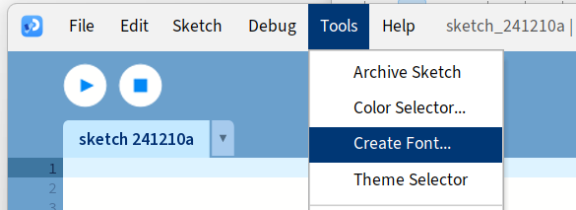
Creating and using custom fonts
Download the processing tool: (https://processing.org/download)
Create a new sketch:
Within the sketch:
Check the next slide:

Slide 19
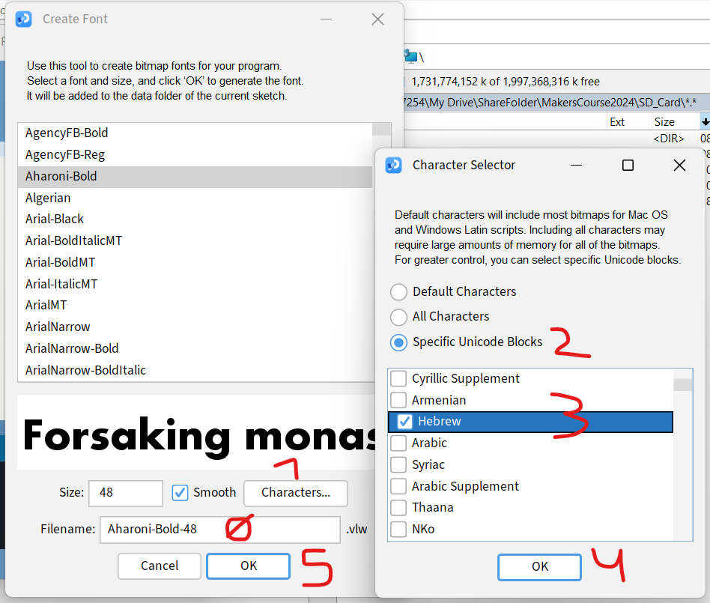
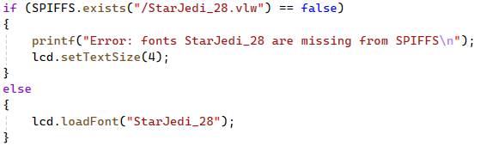
Choose your font and size
Follow the steps and choose size
The VLW file will be places in the sketch’s folder
Load the VLW onto the SPIFFS file system
Usage in the code:
Great site for free fonts: https://www.dafont.com/

Slide 20
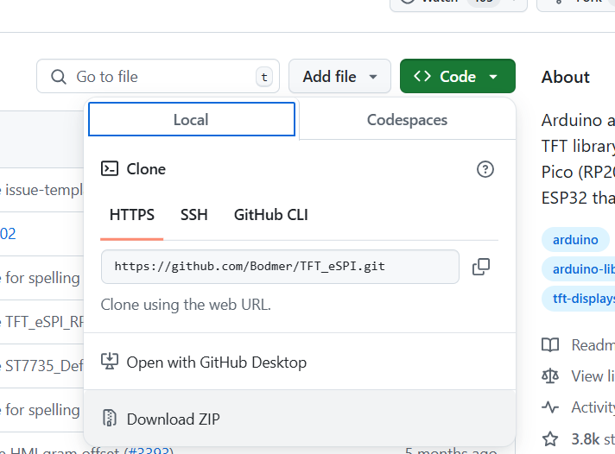
Hands on:
Create a new project named: ESP32_S3_MP_BasicProject
Prepare and SD card formatted in FAT32
Copy the SD_Card folder content into your SD card from: https://drive.google.com/drive/folders/1zq6xBnafNOxvXa-MHr8R3TDQCG0Yzd6z?usp=sharing
Download the TFT_eSPI library from: https://github.com/Bodmer/TFT_eSPI
Copy from the drivers folder in the course GIT the PNG library into Arduino’s libraries folder
Copy the Setup300_MakersMiniPlatform_S3.h into the user setups folder within the TFT_eSPI library
From CodeExamples\BasicProject folder Copy the code from ESP32_S3_MP_BasicProject.ino onto your project

Slide 21
How to use image files in our code
Download or create PNG files
Load them into the SD card
Load them into memory and then into the LCD or sprite
See the code example

Slide 22
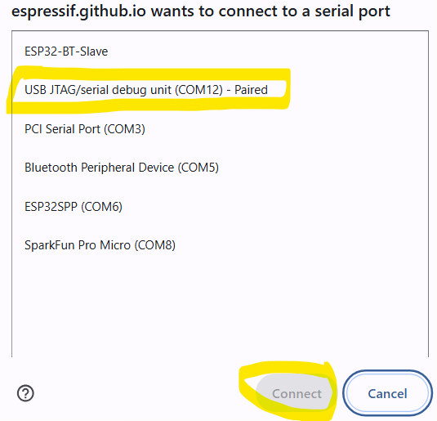
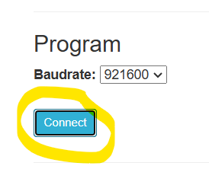
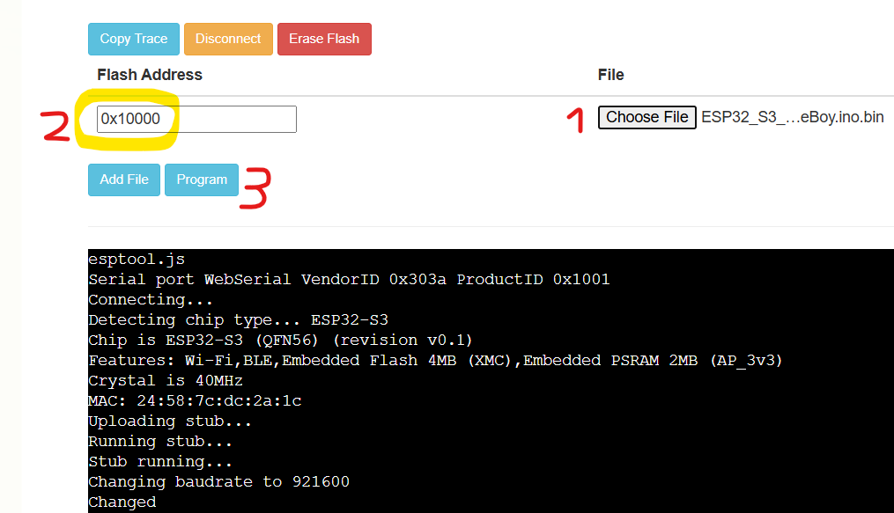
Extras:
How to load bin directly using web interface:
https://espressif.github.io/esptool-js/

Slide 23
Great site for amazing demos and projects:
https://www.youtube.com/@VolosProjects/videos
Most of uses an ESP32-S3 just like we do ☺
Most of them can be ported easily to our platform

